Slide 1

Advantages of Linked Lists
Abdelrahman Elsayed

Slide 2
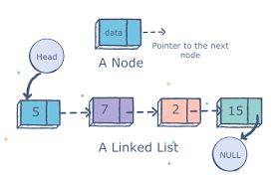
What is a linked list:
A linked list is a linear data structure, in which the elements are not stored at continuous memory locations.
a linked list consists of nodes where each node contains a data field and a reference(pointer) to the next node in the list.
Each linked lists has a head(first node)
The last node is linked to a terminator used to signify the end of the list.

Slide 3
Advantages 0f Linked Lists
Better use of Memory:
-From a memory allocation point of view, linked lists are more efficient than arrays. Unlike arrays, the size for a linked list is not pre-defined, allowing the linked list to increase or decrease in size as the program runs. This is possible because to insert or delete from a linked list, the pointers need to be updated accordingly.

Slide 4
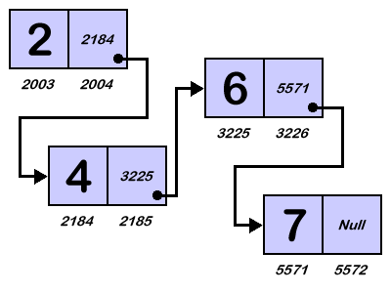
Advantages 0f Linked Lists
Better use of Memory:
-In a linked list, new elements can be stored anywhere in the memory.
Address of the memory location allocated to the new element is stored in the previous node of linked list, hence forming a link between the two nodes/elements.

Slide 5
Advantages 0f Linked Lists
Fast Insertion/Deletion Time:
Inserting a new node to the beginning or end of a linked list takes constant time (O(1)) as the only steps are to initialize a new node and then update the pointers. Likewise, if there were a tail pointer (similar to the head pointer) insertion to the end of the linked list would also be O(1).
Insertion to the middle of the linked list takes linear time (O(n)) as iteration over n elements is required to get to the correct location before inserting the node.
deletion of the nodes at the beginning of the linked list take constant time while deleting a node in the middle and end of the linked list takes linear(O(n)) time.

Slide 6
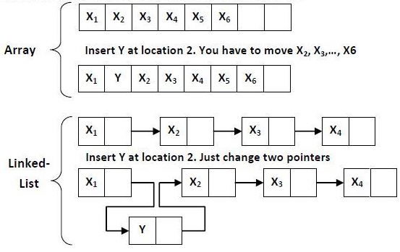
Insertion in a linked lists vs array

Slide 7
Array | Linked List
-Array supports Random Access, which means elements can be accessed directly using their index, like arr[0] for 1st element, arr[6] for 7th element etc. -Hence, accessing elements in an array is fast with a constant time complexity of O(1). | -Linked List supports Sequential Access, which means to access any element/node in a linked list, we have to sequentially traverse the complete linked list, upto that element. -To access nth element of a linked list, time complexity is O(n).
In an array, elements are stored in contiguous memory location or consecutive manner in the memory. | In a linked list, new elements can be stored anywhere in the memory.
Memory is allocated as soon as the array is declared, at compile time. It's also known as Static Memory Allocation. | Memory is allocated at runtime, as and when a new node is added. It's also known as Dynamic Memory Allocation.
Array can be single dimensional, two dimensional or multidimensional. | Linked list can be Linear(Singly), Doubly or Circular linked list.
Array gets memory allocated in the Stack section. | Whereas, linked list gets memory allocated in Heap section.

Slide 8
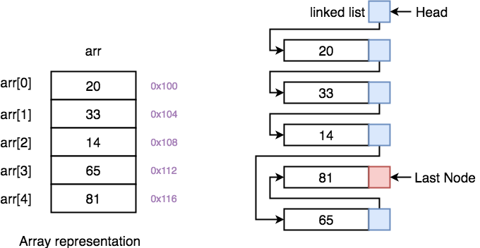

Slide 9
disadvantages 0f Linked Lists
Traversal
Elements or nodes traversal is difficult in linked list. We can not randomly access any element as we do in array by index. For example if we want to access a node at position n then we have to traverse all the nodes before it. So, time required to access a node is large.
Reversing
In linked list reverse traversing is really difficult. In case of doubly linked lists, its easier but extra memory is required for back pointer hence wastage of memory.
Memory Usage
More memory is required to store elements in linked list as compared to array. Because in linked list each node contains a pointer and it requires extra memory for itself.

Slide 10
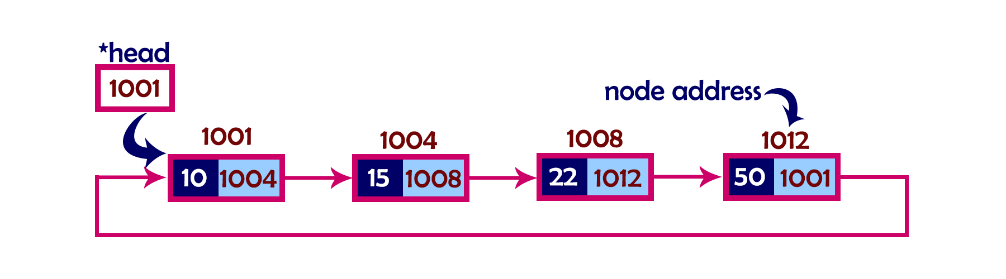
Circular singly linked list
In single linked list, every node points to its next node in the sequence and the last node points NULL. But in circular linked list, every node points to its next node in the sequence but the last node points to the first node in the list.
That means circular linked list is similar to the single linked list except that the last node points to the first node in the list

Slide 11
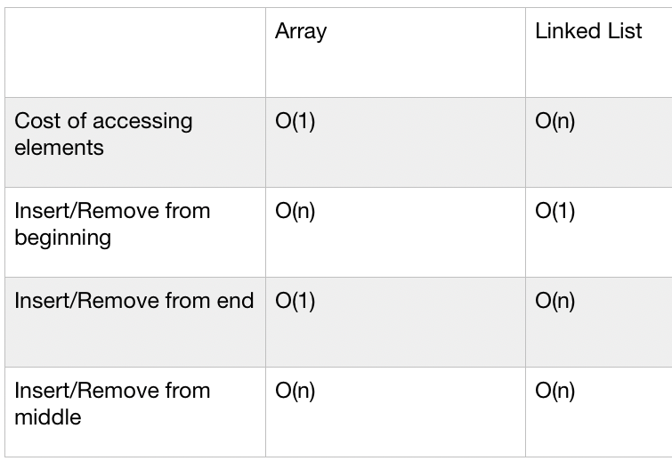
Time complexity-linked list

Slide 12
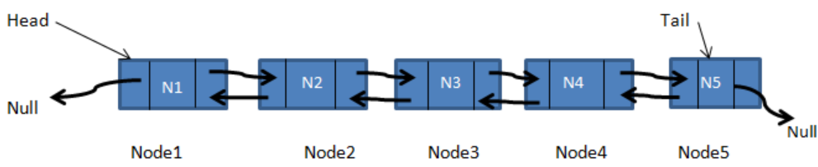
Doubly Linked List
Unlike the singly linked list, a node of a doubly linked list consists of three fields: two pointers and one information field. The two pointers contain the addresses of previous nodes and the next nodes in the sequence and one data field.

Slide 13
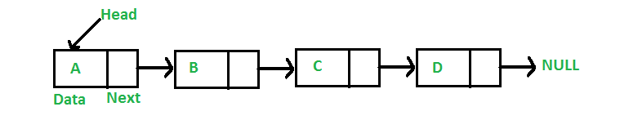
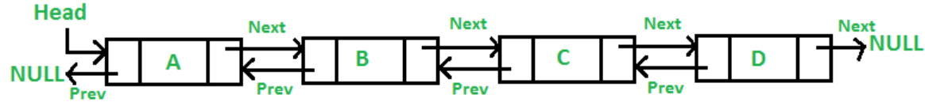
Singly Vs. Doubly linked lists
SINGLY LINKED LIST (SLL) | DOUBLY LINKED LIST (dLL)
SLL has nodes with only a data field and next link field. | DLL has nodes with a data field, a previous link field and a next link field.
In SLL, the traversal can be done using the next node link only. | In DLL, the traversal can be done using the previous node link or the next node link.
The SLL occupies less memory than DLL as it has only 2 fields. | The DLL occupies more memory than SLL as it has 3 fields.
Less efficient access to elements. | More efficient access to elements.

Slide 14
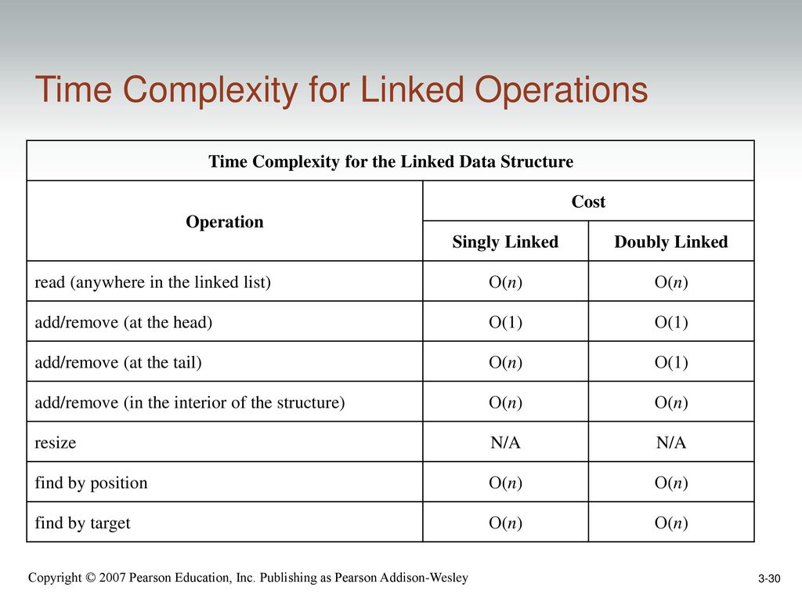
Singly Vs. Doubly linked lists(Time complexity)

Slide 15
Applications of linked list in computer science
Implementation of stacks and queues
Implementation of graphs
Dynamic memory allocation : We use linked list of free blocks.
Maintaining directory of names
Performing arithmetic operations on long integers
Representing sparse matrices

Slide 16
Applications of linked list in real world
Image viewer – Previous and next images are linked, hence can be accessed by next and previous button.
Previous and next page in web browser – We can access previous and next URL searched in web browser by pressing back and next button since, they are linked as linked list.
Music Player – Songs in music player are linked to previous and next song. you can play songs either from starting or ending of the list.

Slide 17
References:
Deepanshi_MittalCheck out this Author's contributed articles., et al. “Applications of Linked List Data Structure.” GeeksforGeeks, 30 Aug. 2018, www.geeksforgeeks.org/applications-of-linked-list-data-structure/.
“Difference between Array and Linked List.” Studytonight.com, www.studytonight.com/data-structures/linked-list-vs-array
InterviewBit. “Linked Lists.” InterviewBit, www.interviewbit.com/courses/programming/topics/linked-lists/

